Slide 1
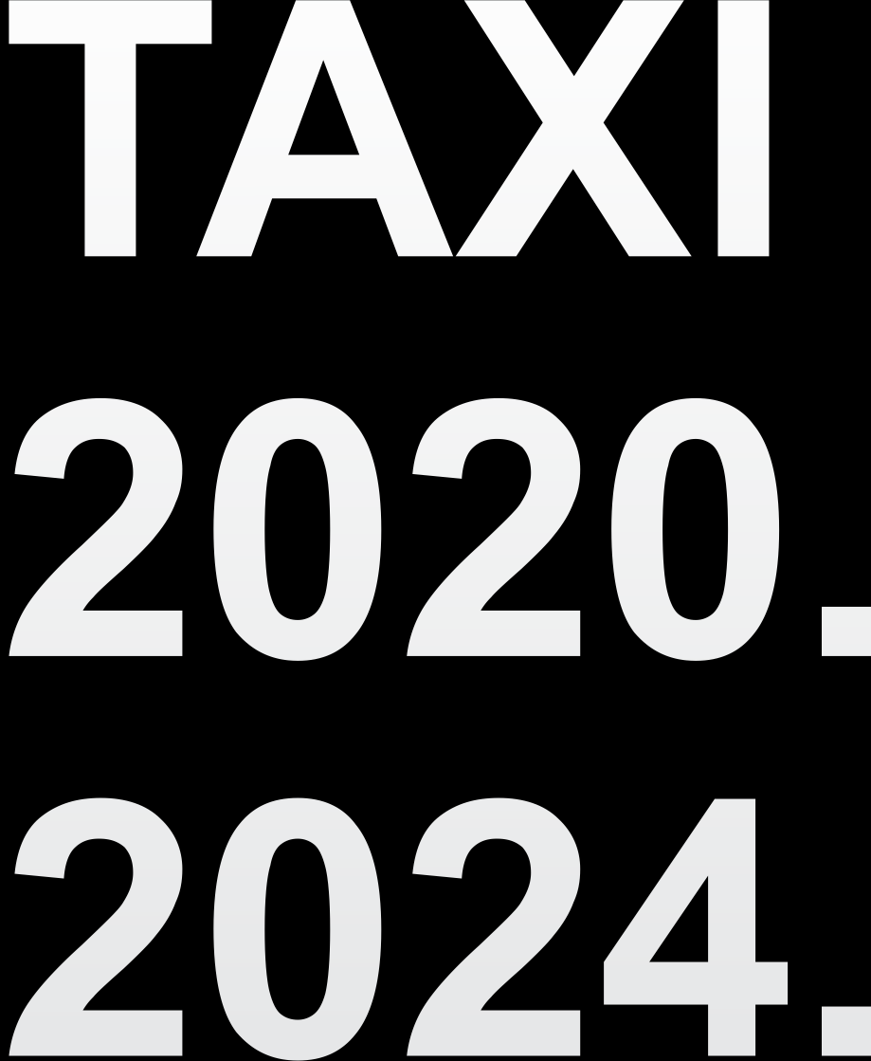
PLANNING AND DESIGN OF THE TAXI SYSTEM
IN BELGRADE FROM 2020 – 2024
PLANIRANJE I PROJEKTOVANЈE SISTEMA TAKSI PREVOZA PUTNIKA U BEOGRАDU ZА PERIOD OD 2020. DO 2024. GODINE

Slide 2
SUBJECT AND OBJECTIVE
SUBJECT OF THE PROJECT
TAXI TRANSPORT is part of a flexible passenger transport subsystem that provides users with a whole day (24/7) public service using vehicles of appropriate capacity at short distances, concerning users' demands and based on predefined and known terms.
PROJECT OBJECTIVE
The main objectives of this research and development project are aimed at creating a scientific and professional basis for changes in the structure, operation, organization and management of the taxi system following a defined transport policy at the level of the city of Belgrade and actual transport needs and demands of the system's users, and creating conditions for the system to become efficient and sustainable.

Slide 3
Main project tasks
Due-diligence analysis of the existing taxi system regarding all elements of the structure, operation, organization and management;
Determining the current strengths and weaknesses, opportunities for and threats to the system (SWOT analysis of the existing system)
Defining a reliable information basis from the existing taxi system through systemic research of the characteristics of the system's users as well as the characteristics of the demands and trips in the system, as the main input for all activities in the process of reengineering and designing;
Designing a new structure and main elements of the taxi system operation in Belgrade based on real data from the system and actual needs of the City of Belgrade's inhabitants;
Reengineering of the existing network of taxi stands in the urban part of Belgrade;
Defining a proposal of the new organization and management model for the taxi system in Belgrade;
Defining the technological process of monitoring and control of the system operation;
Defining the proposal of the amendments to regulatory acts for the implementation of a new system.

Slide 4
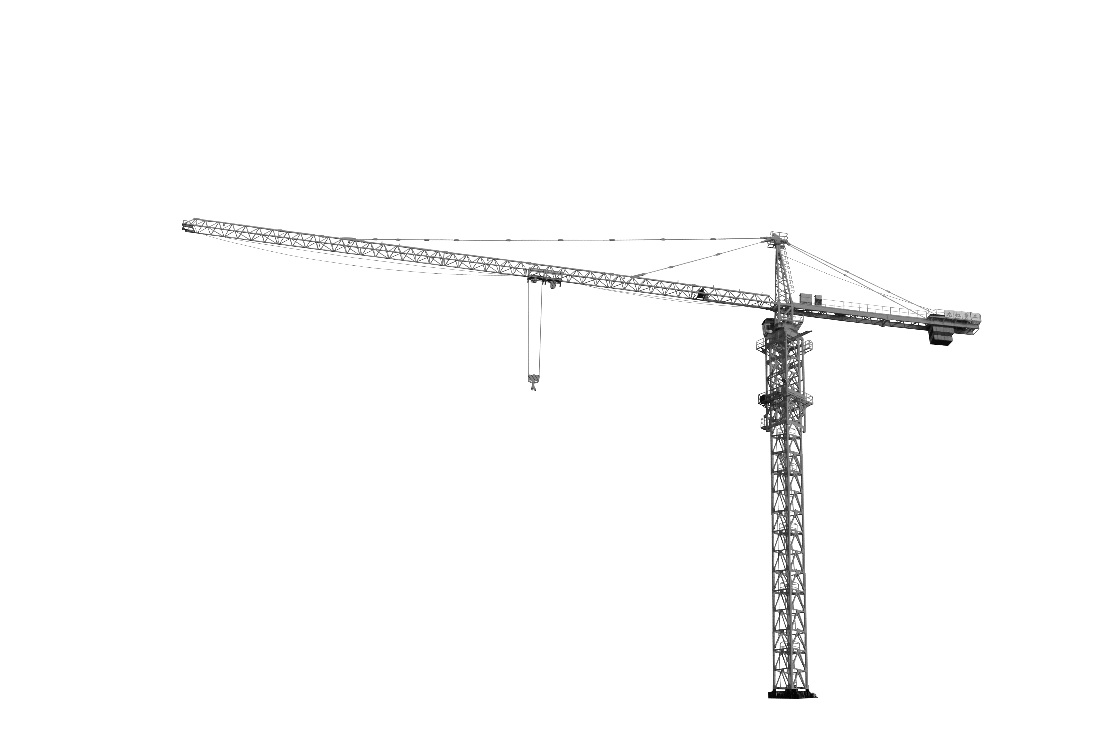


Interoperable approach
.‚‚
.
.
ПОСТОЈЕЋИ
ОПЕРАТОРИ
EXISTING
OPERATORS
TAXI SYSTEM
TAILORED-FIT
FOR BELGRADE

Slide 5
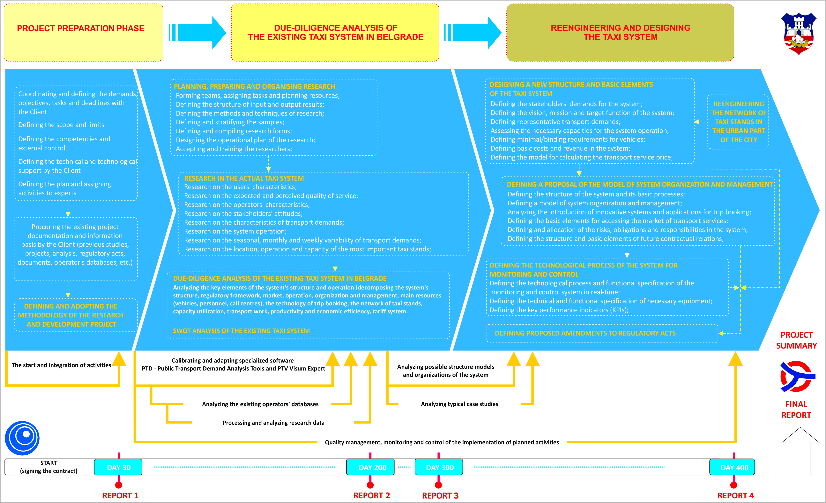
Methodology and phasing of the project

Slide 6

Research in taxi system
    Research and analysis of user characteristics in the taxi system. This type of research was conducted through a users’ survey on a representative sample. A total sample of 2,068 users was collected;
    Research and analysis of the expected and perceived quality of service in the taxi system. A total sample of 2,068 users was collected;
    Research and analysis of the operators' characteristics in the taxi system. This type of research was done using the interview method – by surveying the drivers on a representative sample of 415 taxi drivers in the system;
    Research on attitudes and opinions of experts (representatives of local authorities and existing operators) on certain aspects concerning the system’s improvement in the future. This type of research was done through a survey of experts on a representative sample of 15 experts<
    Research and analysis of locations, operation and capacity of the most important taxi stands in the urban area of the city of Belgrade. A total of 154 stands were recorded;
    Research and analysis of the available databases of the existing operators in the taxi transport market in Belgrade was also conducted (on a representative sample of the operators that account for over 60% of active taxi vehicles in the system):
    Research and analysis of the characteristics of transport demands;
    Research and analysis of the taxi system operation (during 24 hours);
    Research of seasonal, monthly and weekly variations of transport demands.

Slide 7
Research in taxi system - NUMBERS, DATA AND FACTS
6 MONTHS
OF RESEARCH IN THE ACTUAL TAXI SYSTEM IN THE CITY OF BELGRADE
1,030 km²
of the City of Belgrade
154
taxi stands
7
experts from the field of public passenger transport
10
members of the operational team
37
researchers
2,068
surveyed users
6,500
working hours
415
surveyed taxi drivers
60%
of taxi vehicles in the system
15.5 million
requests from databases
While conducting the research 37 researchers and 10 members of the operational team were hired. They invested a total of 2,500 working hours. Apart from the above number of researchers, the planning process of the research included 7 experts from the field of passenger transport, as well as 5 members of the team in the research preparation phase. A total of about 4,000 working hours was invested in these activities.

Slide 8
Research in taxi system – EXPECTED QUALITY OF SERVICE
Users
Experts

Slide 9
Research in taxi system – VEHICLE FLEET
Average vehicle fleet
age is 12,9 years

Slide 10
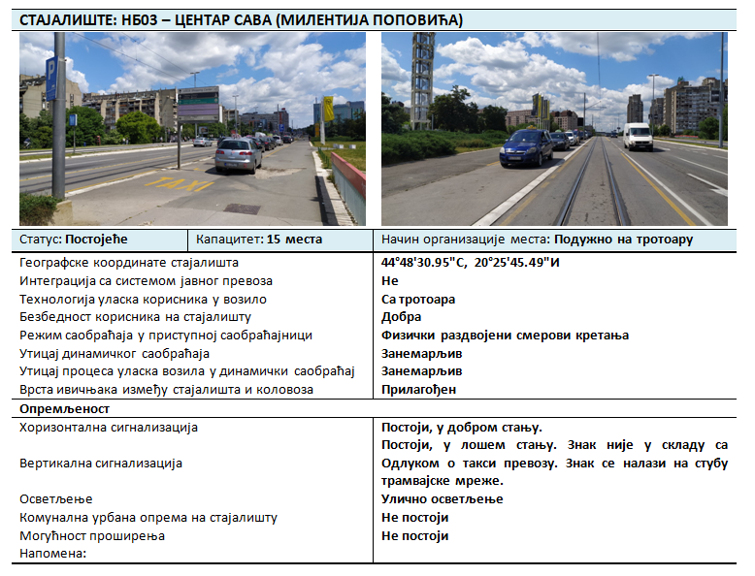
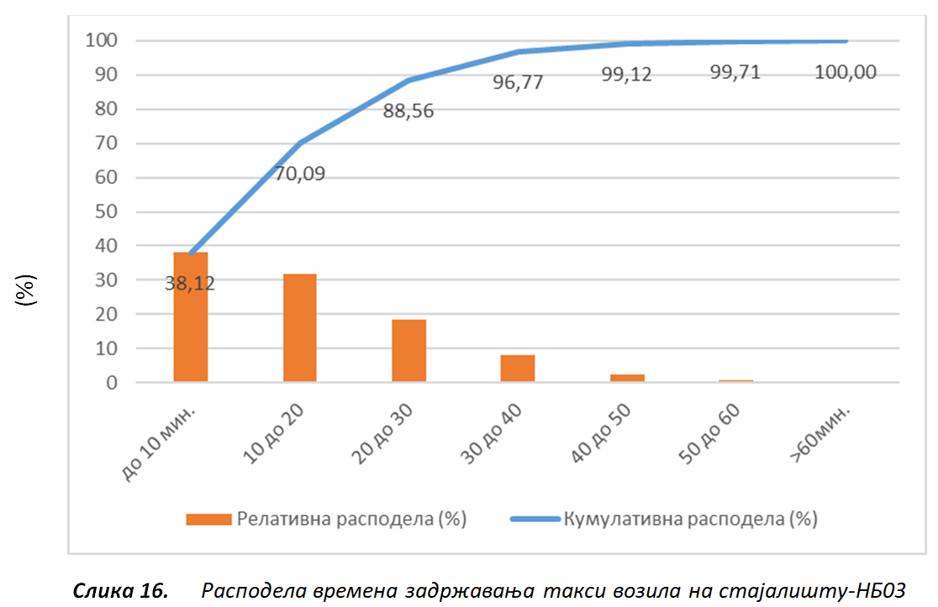
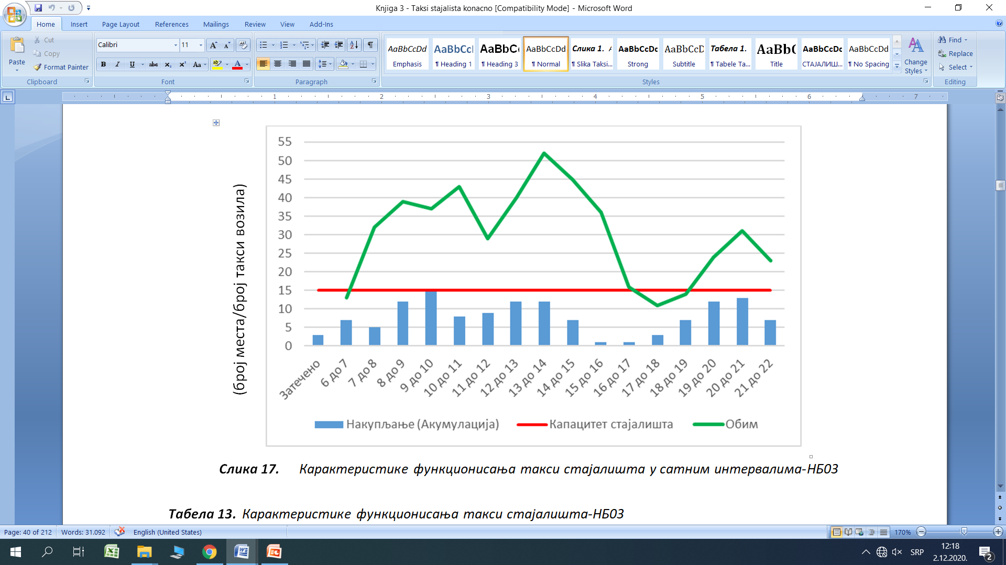
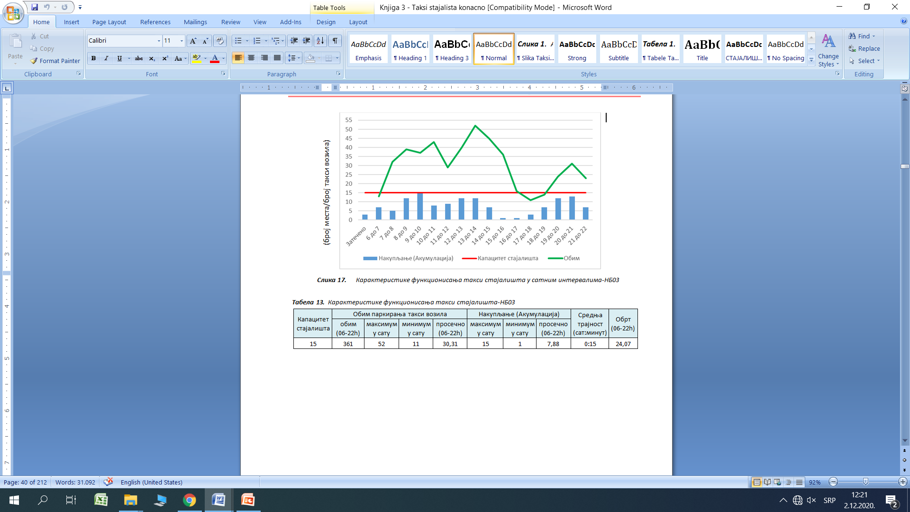
Research in taxi system – TAXI STANDS

Slide 11
Research in taxi system – PERFORMANCE INDICATORS
 | t₅ – time between request acceptance and trip end (98,17%)
t₀ - time between ride requesting to acceptance (1,83%) | t₃ - time between request acceptance and trip start (23,94%) |  | t₄ – ride time (74,23%)
 | t₃₁ - time between request acceptance to arrival at the address (17,66%) | t₃₂ – waiting time at the address (6,28%)
t₁ - time from ride requesting to arrival at the address (19,49%)
t₂ - time from ride requesting to trip start (25,77%)
t₆ - time from ride requesting to trip end (100%)

Slide 12
Research in taxi system – TRANSPORT DEMAND

Slide 13
Research in taxi system – TRANSPORT DEMAND

Slide 14
Research in taxi system – TRANSPORT DEMAND

Slide 15
Vision, mission and target function
VISION of the taxi system in the city of Belgrade should be based on the platform of sustainable mobility of the inhabitants of the City of Belgrade, by providing stable, reliable, accessible in space and time, quality transport services, under the most economically favorable and environmentally-friendly conditions, using modern IoT (Internet of Things) technology.
THE MISSION of the taxi system in the City of Belgrade should be aimed at creating conditions for the system to be sustainable, rational, efficient, safe and secure, modernly organized, environmentally-friendly, focused on producing quality transport services to system users, under economically favorable conditions, in order to achieve system sustainability and the balance between transport supply and demand.
TARGET FUNCTION of the taxi system in the city of Belgrade should be focused primarily on reengineering the organizational - management model at the strategic level of the taxi system, with the application of modern information technology, which will ensure stable production of the required volume and quality of transport service at all times, based on the real operating costs while maximizing efficiency, effectiveness and environmental friendliness.

Slide 16
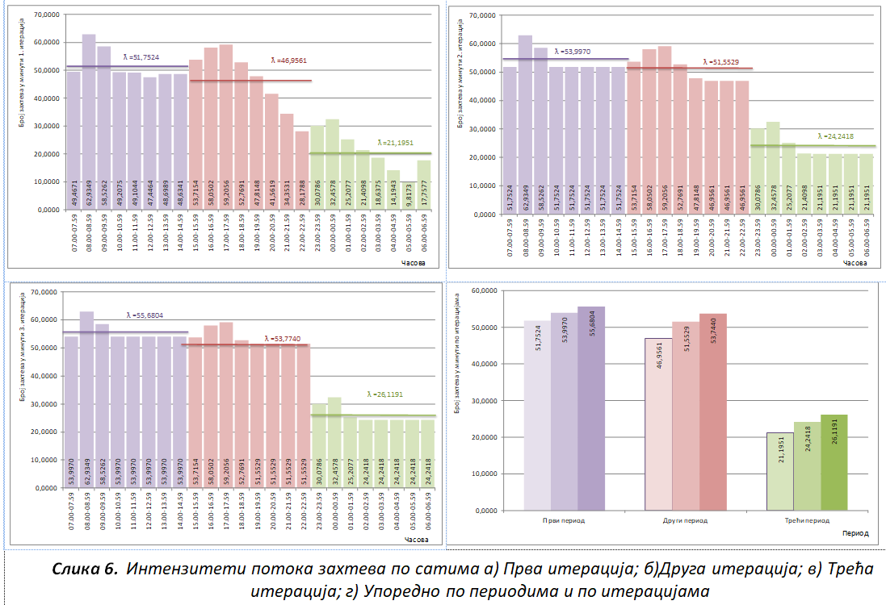
REPRESENTATIVE TRANSPORT DEMAND
Iteration/Transport demand volume per period | Transport demand volume [requests/minute]
 | First period | Second period | Third period
Zero iteration | 51.7524 | 46.9561 | 21.1951
First iteration | 53.9970 | 51.5529 | 24.2418
Second iteration | 55.6804 | 53.7440 | 26.1191

Slide 17
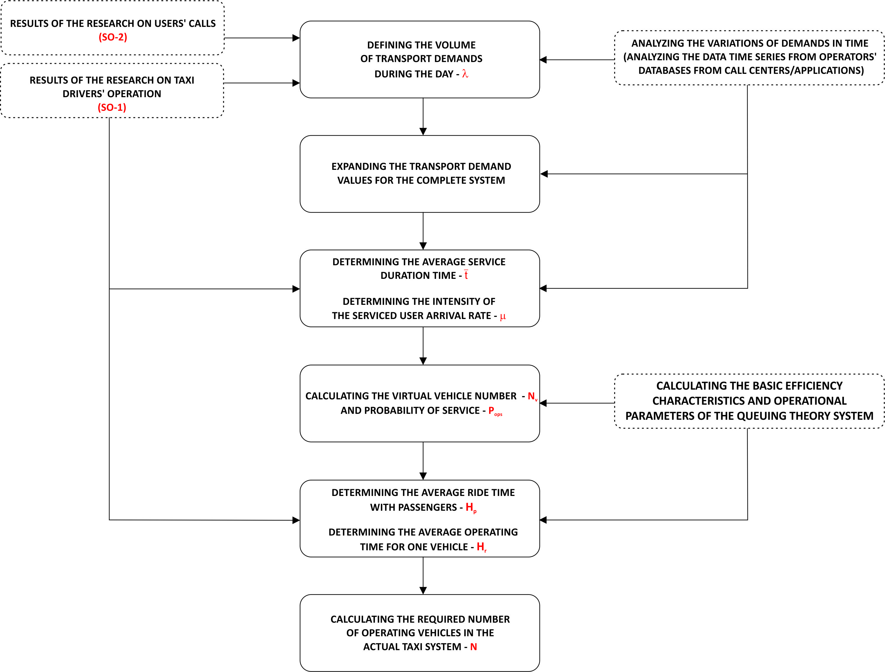
Calculation of the required number of vehicles in the taxi system

Slide 18
Calculation of the required number of vehicles in the taxi system
No | Probability of service – P_{ops} (-) | Number of vehicles – N (vehicles)
1 | P=0.85 | 6,617
2 | P=0.87 | 6,773
3 | P=0.90 | 7,006
4 | P=0.93 | 7,240
5 | P=0.95 | 7,396
6 | P=0.98 | 7,640
THE RECOMMENDED NUMBER OF VEHICLES IN THE TAXI SYSTEM IN BELGRADE FOR THE EXISTING LEVEL OF TRANSPORT REQUIREMENTS, PROBABILITY OF SERVICE 0.90 AND FUNCTIONING CHARACTERISTICS IS: 7.006 VEHICLES

Slide 19
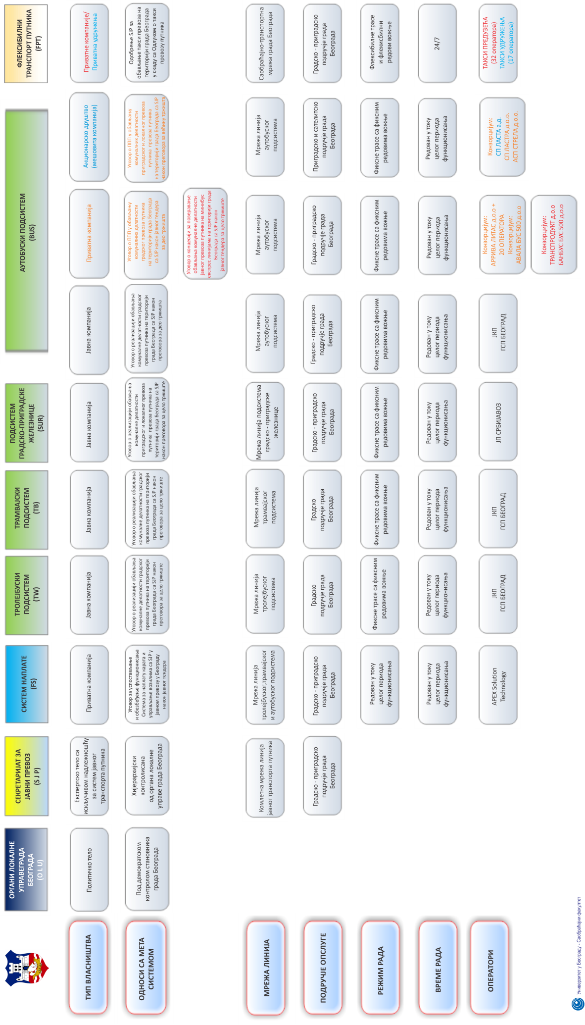
DESIGN OF THE NEW TAXI SYSTEM STRUCTURE

Slide 20
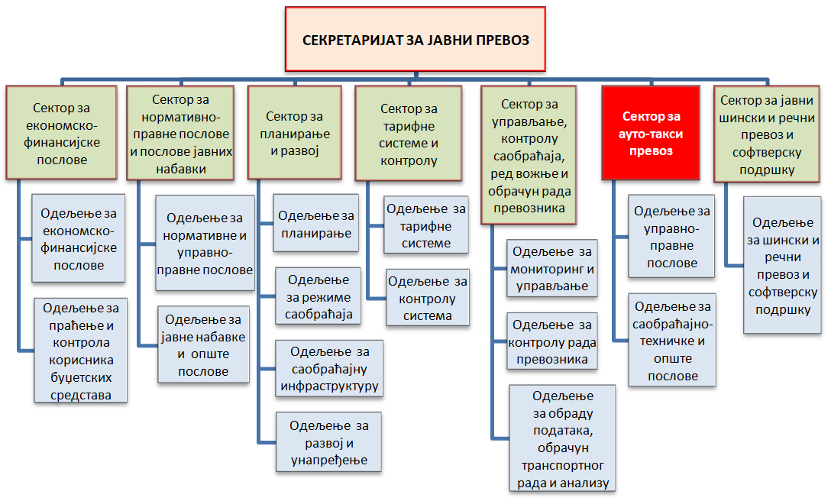
DESIGN OF THE NEW TAXI SYSTEM STRUCTURE

Slide 21
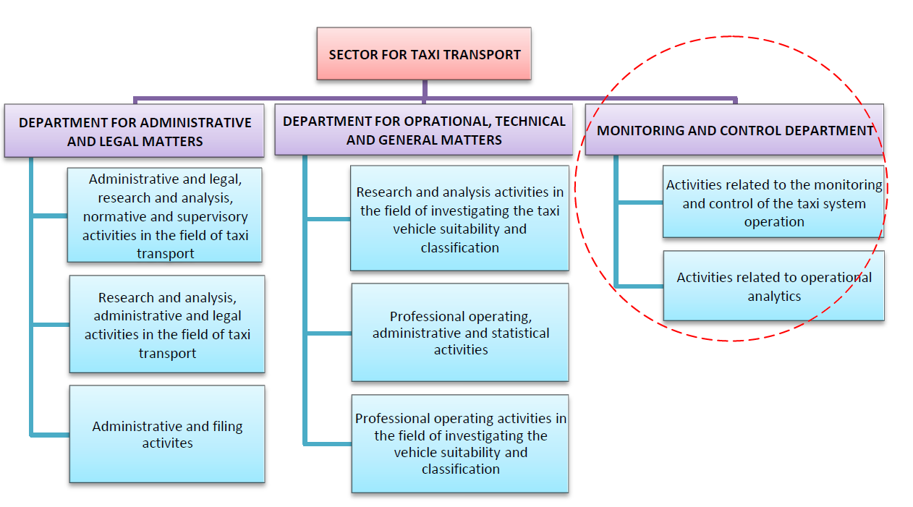
DESIGN OF THE NEW TAXI SYSTEM STRUCTURE

Slide 22
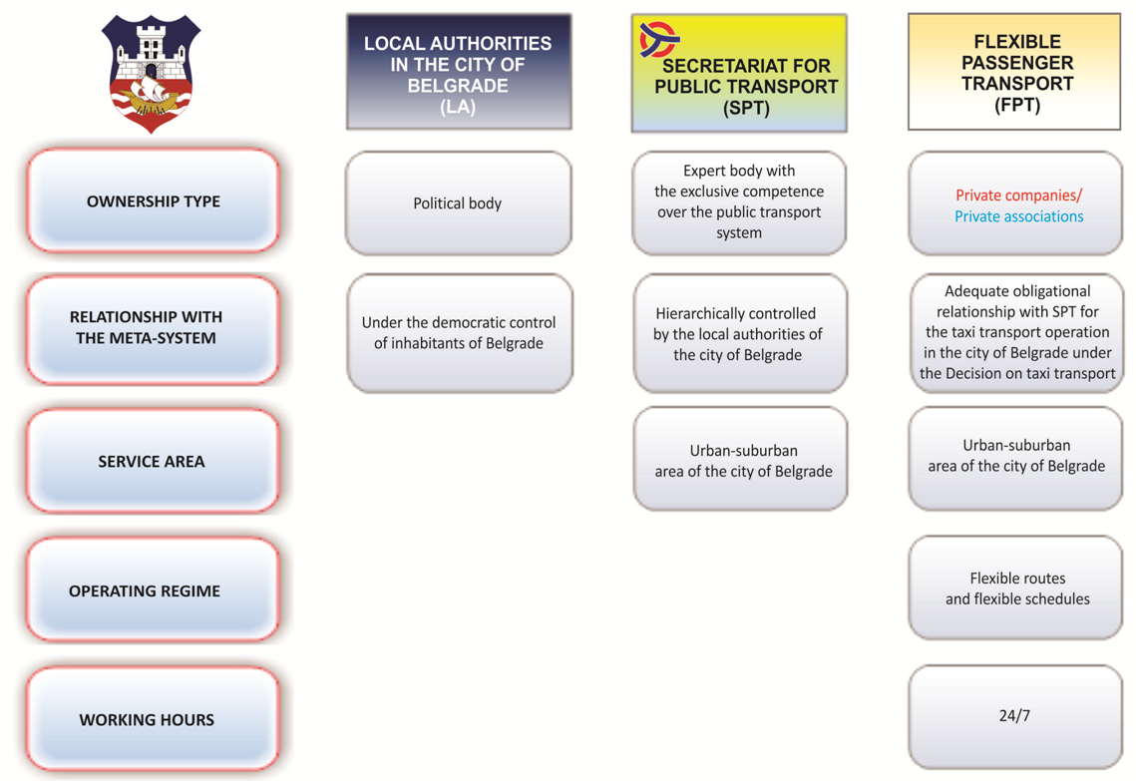
DESIGN OF THE NEW TAXI SYSTEM STRUCTURE

Slide 23
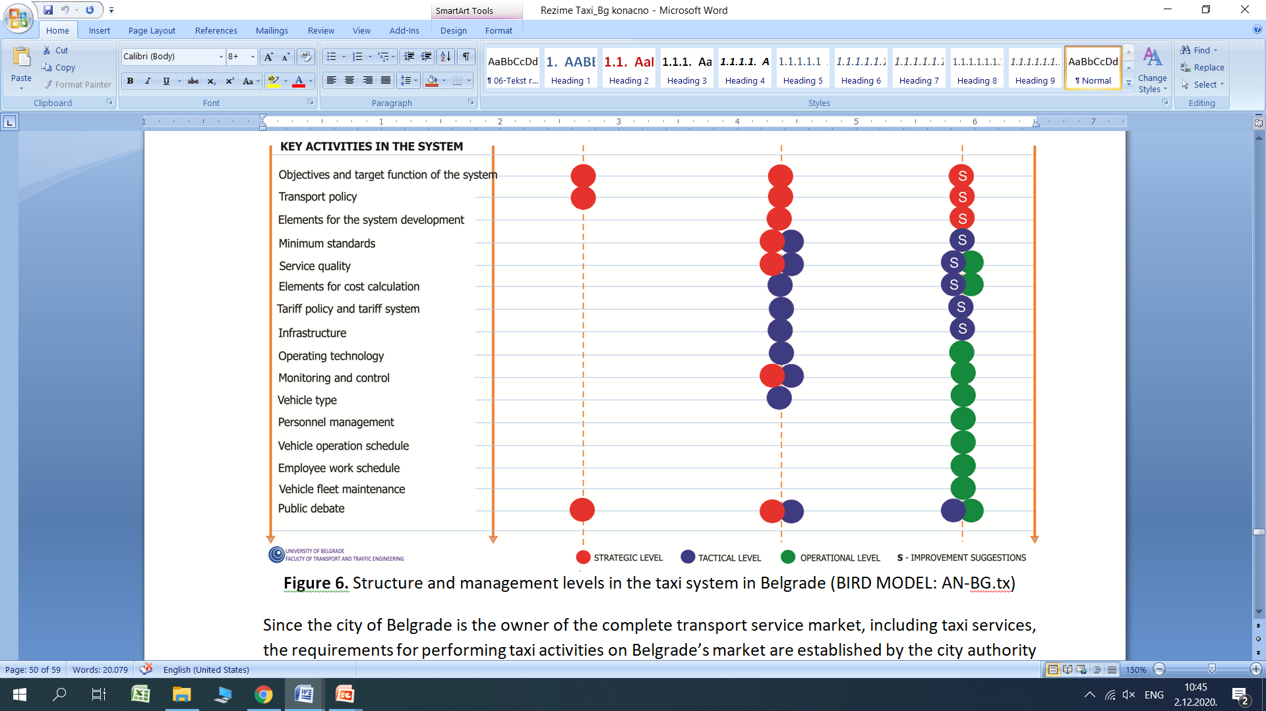
DESIGN OF THE NEW TAXI SYSTEM STRUCTURE

Slide 24
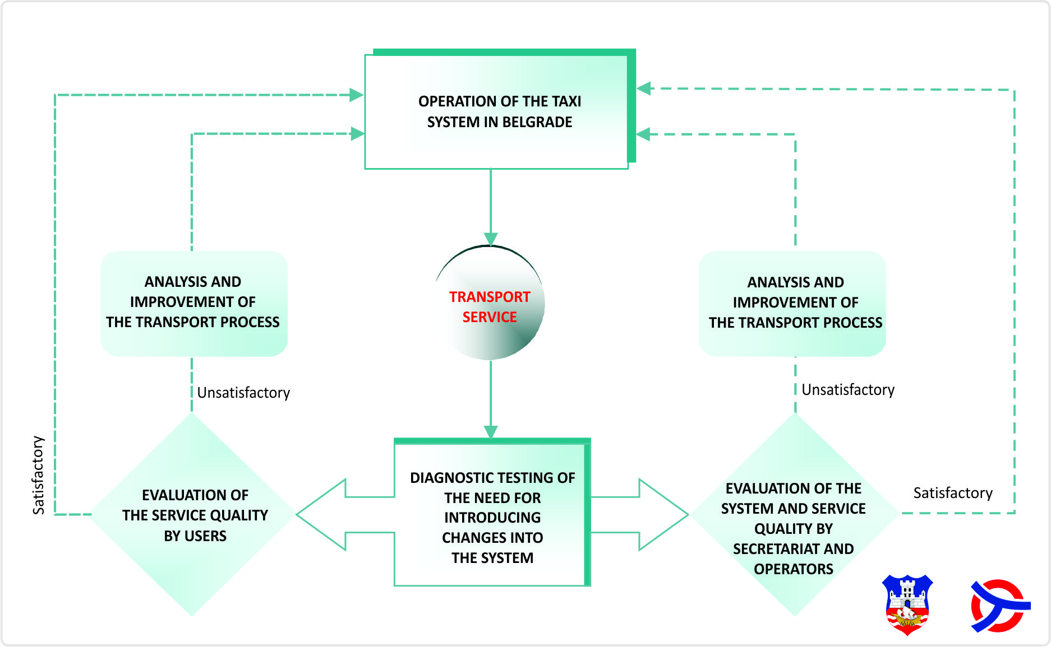
MONITORING AND CONTROL – DIAGNOSTIC TESTING OF THE SYSTEM’S OUTPUTS

Slide 25
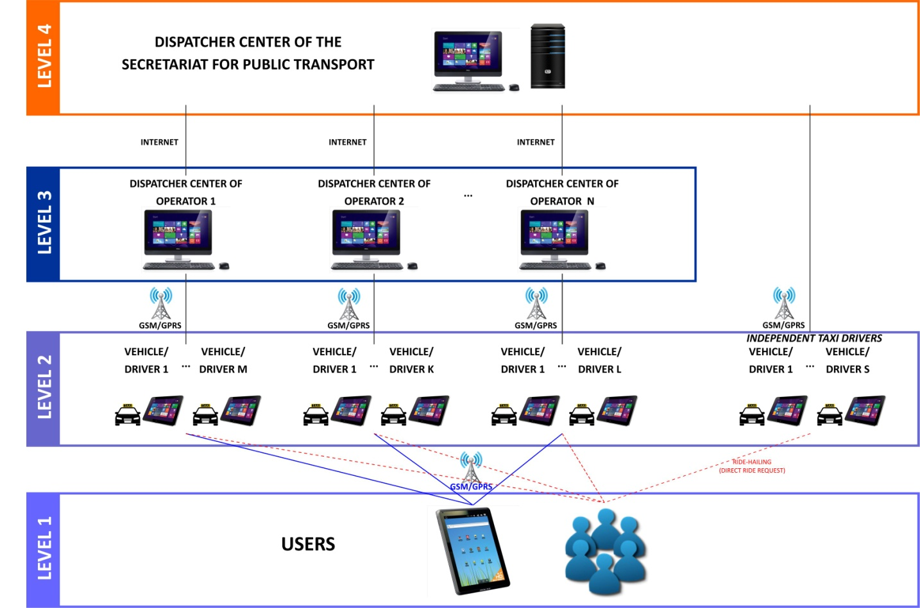
MONITORING AND CONTROL – REAL TIME
THE HIERARCHICAL MODEL

Slide 26
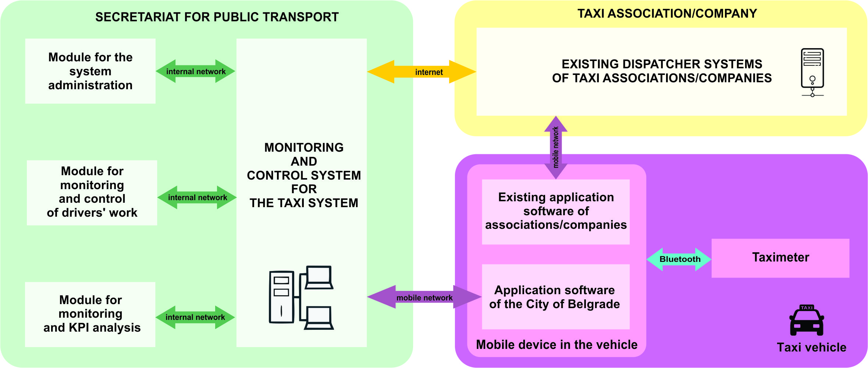
MONITORING AND CONTROL – REAL TIME
THE SYSTEM ARCHITECTURE

Slide 27
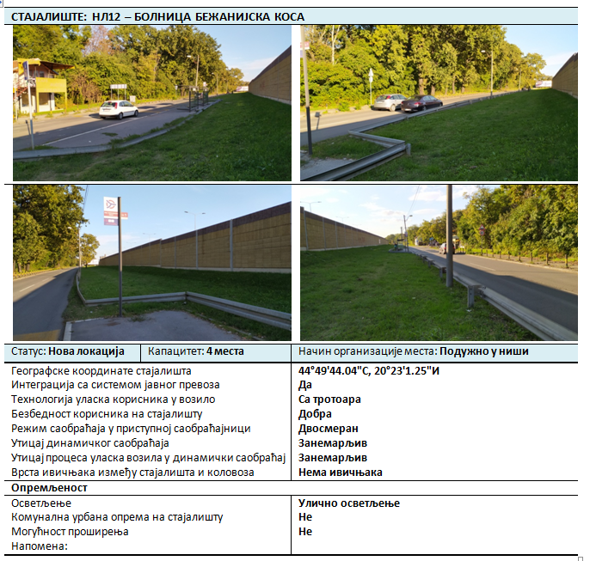
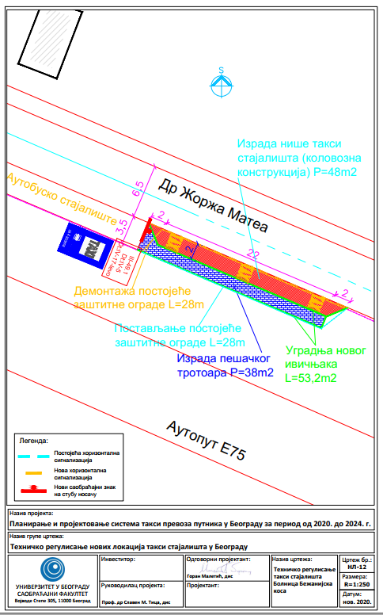
REDESIGN OF THE TAXI STANDS

Slide 28
CONTACTS
UNIVERSITY OF BELGRADE – FACULTY OF TRANSPORT AND TRAFFIC ENGINEERING
Prof. dr Slaven TICA | Doc. dr Predrag ŽIVANOVIĆ | Doc. dr Stanko BAJČETIĆ | Prof. dr Branko MILOVANOVIĆ
T +381 11 3091 384 M +381 64 880 2000 | T +381 11 3091 226 M +381 63 72 42 263 | T +381 11 3091 346 M +381 65 30 20 600 | T +381 11 3091 368 M +381 64 123 67 08
slaven.tica@sf.bg.ac.rs | p.zivanovic@sf.bg.ac.rs | s.bajcetic@sf.bg.ac.rs | b.milovanovic@sf.bg.ac.rs
Project manager
Asiss. Andrea NAĐ
T + 381 11 3091 368 M +381 65 200 5790
andrea@sf.bg.ac.rs

